Slide 1
Mandatory reporting training instructions
Staff must undertake training at the start of each school year.
New staff should undertake training within one week of commencing employment.
It is recommended that:
a minimum of 60 minutes is allocated to delivering the presentation.
copies of the department’s Mandatory Reporting of Harm and Exploitation of Children Guidelines and the presentation are provided to participants.
discussion is encouraged during the training presentation.
participants are provided with a means to anonymously ask questions and voice concerns.
Notes:
The department’s Mandatory Reporting of Harm and Exploitation of Children Guidelines is available from the department’s school policies website: https://education.nt.gov.au/policies/mandatory-reporting-of-harm-and-exploitation-of-children.
Other resources are available on eLearn’s Mandatory reporting training page – https://elearn.ntschools.net/supporting-staff/professional-learning/mandatory-reporting#resources11731
For further information regarding the mandatory reporting guidelines or presentation, contact:
Student Wellbeing and Inclusion Programs and Inclusion
Email: Sesupport.det@education.nt.gov.au
Staff must undertake training at the start of Semester 1 each school year. New staff should undertake training within one week of commencing employment and then renewed at the start of Semester 1 each year. Staff who do not undertake training at the start of the year must complete the training at their earliest convenience

Slide 2
Mandatory Reporting of Harm and Exploitation of Children and Young People
Department of EDUCATION AND TRAINING
Speaker/Business unit name

Slide 3


ACKNOWLEDGEMENT OF COUNTRY
We acknowledge Aboriginal and Torres Strait Islander people as the Traditional Custodians of
this country throughout Australia, and their connection to land, sea, spirit and community.
We acknowledge and pay our respect to ancestors, elders and Aboriginal
communities of the Northern Territory and recognise they are the
custodians of the land on which we live, work and learn.
Fogg Dam, Top End Region
LIMILNGAN-WULNA COUNTRY

Slide 4
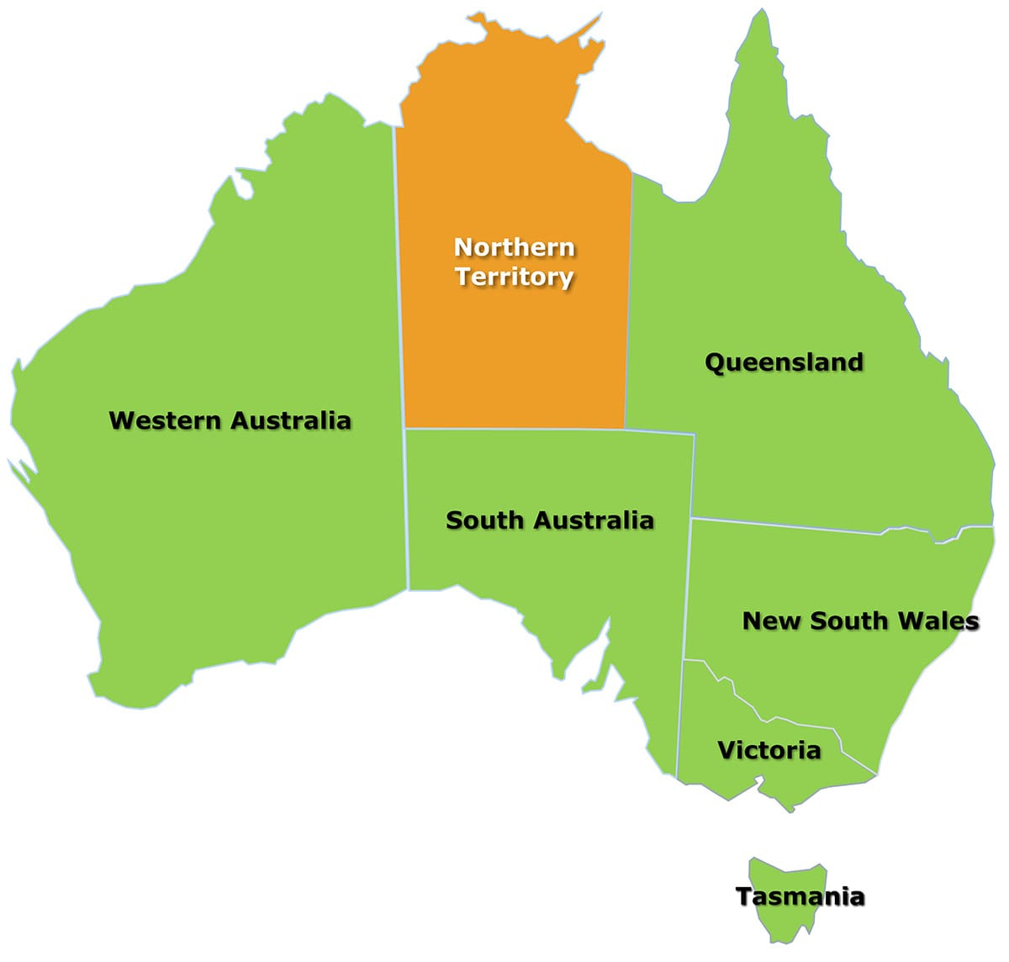
Mandatory reporting in the NT
Who? What? When?
Mandatory reporting legislation is different in every jurisdiction in Australia.
Child protection is everyone's responsibility.
In the NT, everyone is required to report under Section 26 of the Care and Protection of Children Act 2007.
Notes:
Everyone in the NT must report any belief or suspicion that a child is being harmed, exploited, or at risk. Legal requirement under Section 26 – Care and Protection of Children Act 2007 (CPCA).
Failure to report when you hold a reasonable belief is an offence. Domestic & Family Violence: All adults (18+) must report to Police when safe if there is serious physical harm or threat to life/safety.
Mandatory reporting in NT introduced in 1984, strengthened in 2007, with further amendments in 2009 (sexual abuse and health practitioner duties).

Slide 5
Mandatory reporting
The Department of Children and Families (DCF) has responsibility for investigating allegations of child harm or exploitation that is the result of an act or omission of the child’s or young persons parents or carers.
NT Police are responsible for investigating allegations of child harm or exploitation by people who are not part of the child’s household, and the harm or exploitation is not a result of something their parents did, or failed to do, AND allegations relating to criminal or sexual offences.
Notes:
A child in need of care and protection refers to a child:
that has suffered, or is likely to suffer, harm or exploitation because of an act or omission of their parent or caregiver
that has been abandoned and no family member is willing and able to care for the child
whose parents are deceased or unable or unwilling to care for the child and no other family member is able and willing to do so
not under the control of any person and is engaged in conduct that caused, or is likely to cause, harm to the child or other persons.
Criminal offence refers to any act that is harmful to not only individuals but also to a community, society or the state.
Sexual offence refers to an indictable offence involving sexual intercourse or penetration, a sexual relationship, sexual abuse, indecent touching or indecent assault, any other indecent act directed against a person or committed in the presence of a child, making, collecting, exhibiting or displaying an indecent object or indecent material, sexual servitude or any other form of sexual exploitation or an attempt to commit an act of procuring or any other act preparatory to the commission of the above.

Slide 6
Role and responsibilities
Education staff should make a mandatory report if they believe on reasonable grounds that a child / young person:
  has suffered, or is likely to suffer, harm or exploitation
  aged less than 14 years has been, or is likely to be, a victim of a sexual offence
  aged less than 14 years is, or is likely to be, sexually active even if that child’s parent is aware of the situation
  over the age of 16 years and in a special care relationship has been, or is likely to be, a victim of an offence according to the Criminal Code Act
  is exposed to domestic and family violence
  has been, or is likely to be, a victim of criminal or sexual offences, including sexual misconduct against a student by a co-worker or colleague.
Notes:
The role and responsibilities of staff and volunteers are set out in the department's mandatory reporting guidelines (page 7).
The guidelines and presentation have been revised to reflect three key developments that have resulted from:
Recommendations made by the 2013 Royal Commission into the Institutional Responses to Child Sexual Abuse regarding child safe organisations.
Release of the NT Domestic, Family and Sexual Violence Reduction Framework 2018-28 – all government agencies are committed to ensuring policies support the requirements to report and reduce domestic, family and sexual violence.
Recommendations made by an independent review.
Additionally, a number of administrative amendments have been made to clarify responsibilities, improve readability and conform to contemporary NT Government style requirements.
The amendments made do not change the intent of the guidelines or increase the responsibilities of school and corporate staff.

Slide 7
Role and responsibilities continued
Inform Principal/Director/Manager when a mandatory report has been made.
Understanding and supporting the National Principles for Child Safe Organisations, in particular:
  complying with obligations of information sharing and record keeping
  recognising the signs of harm and facilitating child-friendly ways for children to communicate and raise concerns
  participating in continual education and training to develop knowledge, skills and awareness to keep students safe.
Undertaking mandatory reporting training at the start of the year or within a week of commencing, and signing the attendance acknowledgement, if they work directly with students.
Notes:
The role and responsibilities of staff and volunteers are set out in the department's mandatory reporting guidelines (page 7).
The guidelines and presentation have been revised to reflect three key developments that have resulted from:
Recommendations made by the 2013 Royal Commission into the Institutional Responses to Child Sexual Abuse regarding child safe organisations.
Release of the NT Domestic, Family and Sexual Violence Reduction Framework 2018-28 – all government agencies are committed to ensuring policies support the requirements to report and reduce domestic, family and sexual violence.
Recommendations made by an independent review.
Additionally, a number of administrative amendments have been made to clarify responsibilities, improve readability and conform to contemporary NT Government style requirements.
The amendments made do not change the intent of the guidelines or increase the responsibilities of school and corporate staff.

Slide 8

Understanding harm and exploitation

Slide 9
What is harm?
Harm to a child is any significant effect caused by any act, omission or commission described as:
the physical, psychological or emotional wellbeing of the child
the physical, psychological or emotional development of the child
the emotional abuse or neglect, or sexual abuse or other exploitation of a child
the exposure of a child to physical violence.
What is exploitation?
Exploitation of a child includes any sexual abuse of a child, any forms of exploitation, or involving the child as a participant or spectator in any act of a sexual nature, prostitution or pornographic performance.

Slide 10
Understanding harm and exploitation
PHYSICAL
CUMULATIVE
HARM
SEXUAL
EMOTIONAL
NEGLECT
GROOMING
Note this falls under sexual harm

Slide 11
Physical Harm
Physical harm refers to all non-accidental physical injuries or impairment or where there is significant risk of injuries occurring.
This also includes when child or young person is living with and experiencing domestic violence at home or within their community.
Physical harm by a parent to a child can be caused by actions such as the child being, for example: punched, kicked, slapped, shaken, bitten, burnt, hit or injured by an object.

Slide 12
Sexual Harm
Sexual harm occurs when an older, more powerful, or more influential person involves a child or young person in any sexual activity or sexual threat. It represents an abuse of power and a betrayal of the child’s trust.
Coercion—physical, emotional, relational, or through manipulation—is central to sexual abuse. Children’s dependency, immaturity, and inability to consent make them especially vulnerable to exploitation.
Talk to child in a sexual or inappropriate way
Genital exposure or forcing a child to view another person’s genitals
Fondling, sexual touching, or forcing a child to touch others
An adult showing genitals to a child via livestream
A child being threatened or blackmailed after sending a sexualised image of themselves.
Notes:
Summary – Sexual Harm to a Child or Young Person
Sexual harm occurs when an older, more powerful, or more influential person involves a child or young person in any sexual activity or sexual threat. It represents an abuse of power and a betrayal of the child’s trust.
Coercion—physical, emotional, relational, or through manipulation—is central to sexual abuse. Children’s dependency, immaturity, and inability to consent make them especially vulnerable to exploitation.
Sexually abusive behaviours can include:
• Exposing a child to sexually explicit material
• Taking or sharing sexualised photographs of a child or young person
• Genital exposure or forcing a child to view another person’s genitals
• Fondling, sexual touching, or forcing a child to touch others
• Voyeurism or persistent intrusion into a child’s privacy
• Digital, penile, or object penetration
• Child Sexual Exploitation (CSE)
• Female genital mutilation (FGM)
These behaviours constitute sexual abuse and always require a response, including consideration of mandatory reporting obligations.
Special Care – relationship Unequal power relationships – for example, a 16-year-old student and their 19-year-old coach.
Student is legally allowed to have sex but because the coach is in power relationships this would warrant a mandatory report to DCF.

Slide 13
Grooming
Grooming is when an individual builds a false sense of trust or a ‘special relationship’ with a child or young person in order to manipulate, exploit, or sexually harm them. It often involves gradual boundary‑pushing and emotional manipulation.
Grooming behaviours may include:
Spending special or excessive time with a particular child
Giving gifts, treats, or extra privileges to the child
Showing favouritism to that child over others
Testing, crossing, or breaking professional boundaries to desensitise the child.
Grooming is a deliberate process used to create opportunities for abuse, reduce the likelihood of disclosure, and increase the child's dependency on the adult.
Notes:
Grooming is when an individual builds a false sense of trust or a ‘special relationship’ with a child or young person in order to manipulate, exploit, or sexually harm them. It often involves gradual boundary‑pushing and emotional manipulation.
Grooming behaviours may include:
• Spending special or excessive time with a particular child
• Giving gifts, treats, or extra privileges to the child
• Showing favouritism to that child over others
• Allowing or encouraging the child to ignore rules or boundaries
• Testing, crossing, or breaking professional boundaries to desensitise the child
Grooming is a deliberate process used to create opportunities for abuse, reduce the likelihood of disclosure, and increase the child's dependency on the adult.

Slide 14
Emotional Harm
Emotional harm occurs when a child’s social, emotional or cognitive development is impaired, or is at significant risk, as a direct result of a carer’s persistent failure to meet the child’s emotional need for love and security, or their psychological needs for stimulation/nurturing.
Constant criticism, belittling, mocking or humiliation
Telling a child they are unwanted, unloved or a burden
Hearing threats, yelling or physical assaults
Living in an environment of fear, instability or coercive control
Ignoring the child's basic emotional needs, (comfort, reassurance and attention)
Exposing child to substance abuse and or criminal behaviour.
Notes:
Examples of Emotional Harm – Child Protection Context
1. Persistent rejection or hostility
• Regularly telling a child they are unwanted, unloved, or a burden.
• Consistently criticising, belittling, mocking, or humiliating the child.
• Showing clear favouritism toward siblings and excluding the child.
2. Exposure to family violence
• Witnessing violence between adults in the home.
• Hearing threats, yelling, or physical assaults.
• Living in an environment of fear, instability, or coercive control.
3. Emotional unavailability or lack of affection
• A caregiver who is consistently unresponsive, cold, or withdrawn.
• No comfort, support, or interest in the child’s wellbeing or achievements.
• Ignoring the child’s basic emotional needs (comfort, reassurance, attention).
4. Terrorising or threatening the child
• Using intimidation, threats, or extreme punishment.
• Threatening abandonment ("I’ll leave you behind if you don’t behave").
• Threatening harm to the child, their pets, or loved ones.
5. Developmentally inappropriate expectations
• Placing adult responsibilities on the child (parentification).
• Expecting perfection or unachievable high performance.
• Blaming the child for adult problems (e.g., finances, relationship issues).
6. Corrupting or exploiting the child emotionally
• Encouraging the child to participate in harmful behaviours.
• Exposing the child to adult conflict, substance abuse, or criminal behaviour.
• Using the child as an emotional partner (confiding adult issues they cannot process).
7. Isolation
• Preventing the child from seeing friends or extended family.
• Stopping them from participating in school, cultural, or community activities.
• Restricting normal social interaction in a punitive or controlling way.
8. Exposure to chronic stress or unpredictability
• Living with caregivers who are highly inconsistent, unreliable, or volatile.
• Frequent changes in caregivers, routines, or home environment.
• Caregiver behaviour that creates constant fear, confusion, or instability.

Slide 15
Neglect
Neglect is the repeated failure to meet a child’s basic physical and emotional necessities of life including:
  Failure to protection child from known risk (unsafe adults, access to weapon or drugs)
  Lack of safe sleeping arrangements (repeated homelessness, , sleeping in unsafe locations)
  Patterns of unexplained or unaddressed nonattendance where carer giver behaviour contributes to chronic absenteeism. (Education-attendance is also a school responsibility not just DCF)
  Ongoing lack of access to clean clothing, bathing or hygiene supplies
  Ignoring or delaying medication treatment for illness, injuries etc.
Notes:
Examples of Neglect – Child Protection Context
1. Inadequate Supervision
• Leaving a child unattended for long periods or in situations beyond their developmental capacity.
• Failing to protect a child from known risks such as unsafe adults, hazardous environments, or access to substances.
• Allowing young children to care for themselves or siblings without appropriate supervision.
2. Inadequate Shelter and Unsafe Living Conditions
• Consistently unsafe, unhygienic, or structurally unsound living environments.
• Chronic exposure to hazards such as exposed wiring, dangerous animals, accumulated rubbish, or household violence.
• Lack of safe sleeping arrangements or repeated homelessness.
3. Insufficient Nutrition
• Failure to provide adequate, age‑appropriate food and hydration.
• Persistent hunger, malnutrition, or food insecurity due to caregiver inaction.
• Not providing dietary requirements for children with medical conditions or disabilities.
4. Failure to Support Education
• Patterns of unexplained or unaddressed non‑attendance where caregiver behaviour contributes.
• Failure to enrol a child in school or respond to school communication.
• Note: School attendance is primarily a school responsibility, not DCF.
5. Poor Personal Hygiene
• Persistent lack of access to clean clothing, bathing, toileting, or hygiene supplies.
• Clothing consistently inappropriate for weather conditions.
• Untreated hygiene‑related concerns such as head lice or skin infections.
6. Failure to Provide Medical, Dental, or Therapeutic Care
• Ignoring or delaying treatment for injuries, illnesses, or chronic conditions.
• Failure to attend required appointments, immunisations, or specialist care.
• Not obtaining essential medications or medical aids such as glasses or asthma inhalers.
7. Emotional and Developmental Neglect
• Failure to provide emotional support, comfort, or engagement.
• Lack of interest in the child’s routines, development, or achievements.
• Failure to provide stimulation, boundaries, or consistent caregiving.
8. Abandonment or Failure to Arrange Appropriate Care
• Leaving a child without arrangements for safe and suitable caregiving.
• Not returning to collect the child as agreed.
• Repeatedly leaving the child with unsafe or unwilling caregivers

Slide 16
Cumulative Harm
Cumulative harm refers to the ongoing, repeated or combined impact of multiple adverse experiences in a child’s life. These experiences may seem low‑level on their own, but over time they accumulate, causing significant harm to a child’s safety, development, wellbeing, and long‑term outcomes.
It results from multiple incidents of maltreatment, neglect, exposure to violence, inconsistent caregiving, or chronic instability.
Harms may be small but persistent, and together they create a compounding negative effect.
Cumulative harm often develops over months or years, making it less obvious but highly impactful.
It can affect a child’s physical, emotional, cognitive, and social development, increasing long‑term vulnerability.
Early identification is important because the pattern over time is often more damaging than any single event.
Notes:
Examples of Cumulative Harm
1. Chronic neglect over time
• Irregular meals, inconsistent supervision, and untreated health issues occurring repeatedly.
• Ongoing poor hygiene and inadequate clothing that persist across months or years.
• Patterns of absenteeism linked to long-term caregiver inaction.
• Even if each incident appears “minor,” the repeated pattern leads to significant developmental and wellbeing impacts.
2. Exposure to ongoing family violence
• Regularly witnessing shouting, threats, or intimidation between adults.
• Living in a home with unpredictable outbursts, police callouts, or coercive control.
• Chronic fear or hypervigilance due to recurring conflict.
• The cumulative emotional impact is far greater than any single incident.
3. Multiple forms of emotional harm across childhood
• A caregiver who is consistently emotionally unavailable or dismissive.
• Frequent put-downs, criticism, or belittling.
• Unpredictable responses (warm one day, hostile the next).
• The pattern of instability over years interferes with attachment, trust, and self-esteem.
4. Repeated changes in caregivers, home environments, or schooling
• Moving frequently between relatives, carers, or homes.
• Being placed with multiple informal caregivers.
• Switching schools multiple times in a short period.
• These disruptions compound and affect the child’s emotional security, education, and social development.
5. Chronic exposure to substance misuse in the household
• Caregivers who regularly intoxicate themselves, leading to poor supervision.
• Exposure to dangerous or unsafe behaviour when adults are under the influence.
• Inconsistent routines, meals, and emotional care.
• The ongoing pattern places the child in sustained unsafe and emotionally unstable conditions.
6. Long-term marginalisation or exclusion
• Persistent isolation due to caregiver choices or community factors.
• Repeated experiences of bullying without caregiver or school response.
• Chronic disengagement from school or community because concerns are never addressed.
• The ongoing lack of intervention contributes to cumulative harm.
7. Multiple low-level injuries or safety concerns
• Frequent minor injuries with inadequate explanations.
• Repeated exposure to unsafe environments (e.g., dangerous animals, hazardous home conditions).
• Ongoing lapses in safety that individually may not meet the threshold but collectively indicate significant risk.
8. Repeated exposure to adult conflict, instability, or chaos
• Adults coming and going from the home unpredictably.
• Recurring conflict with neighbours, extended family, or partners.
• Chronic stress from household instability, impacting emotional regulation and development.

Slide 17
Responding to a disclosure
Listen actively and allow the child to speak with minimal interruption. Reassure them as they share.
After they finish, ask open‑ended, non‑leading questions only to gather enough information to make a mandatory report. Avoid causing distress.
Use age‑appropriate language to explain that you cannot keep the information confidential and must report it to keep them safe.
  Younger children: Thank them, reassure them you believe them, and explain that you will speak to someone who can help.
  Older children: Thank them, affirm belief, and explain you must report it to specialists for their safety.
Reassure the child that telling someone was the right thing to do and that reporting helps stop or prevent harm.
Do not investigate or question others. Only DCF and/or Police conduct investigations.
Notes:
Listen
Be calm, patient and listen supportively to the student - let them give their own account without being prompted for responses.
Do not pressure the student into telling you more than they want to.
Always give the student time – don’t interrupt. Do not make them feel rushed or panicked.
You can take notes, but your role is not to investigate, nor are you expected to be a counsellor.
Take notes in a way that doesn’t cause concern or discomfort – don’t impede the student’s speech.
Reassure
Help the student feel safe to talk. Your manner is important – don’t rush, be attentive and show concern.
Do not display any signs of judgment or disbelief, no matter how fragmented or disorganised their story may seem.
Consider whether a support person is necessary i.e. another teacher, assistant teacher or staff member.
Reassure the student that telling someone was the right thing to do.
Respect
Respect that the student may only reveal some details. The trauma they have experienced can damage a child’s ability to speak freely or recall information in a sequential/logical manner.
Tell the student that you are going to talk to others whose job it is to keep them safe.
Acknowledge their bravery and strength in talking to someone who can help.
Tell the student you will need to let certain people know and that they will help solve the problem.
Reassure the student that you will only tell people who need to know.
Reiterate to the student that you are taking these actions in order to keep them safe.
Avoid
Pressuring the student into telling you more than they want to.
Do not go over the information repeatedly (you are only gathering information to help you form a belief on reasonable grounds that you need to make a report and/or take further action).
Do not make promises. There are no guarantees that promises you make are able to be kept.
Control emotional response – don’t display feelings of anger, shock, sadness, disgust etc.
A critical element of responding to incidents and student disclosures is gathering and recording information. Information recorded needs to be accurate, factual and without bias as it may be used in decision making and/or reporting and has the potential to impact one or more people.
Record any necessary details that the student provides during their recount/disclosure – capture the basic facts. It is important to establish the nature of what has occurred but avoid going into details of specific acts or events. If the student is speaking freely allow them to do so and record necessary details, using the student’s exact words as much as possible.

Slide 18

Responding to sexualised behaviours in children

Slide 19
How to respond
The Sexual Behaviour in Children Guidelines (available on the NT DET website) outlines how to identify and respond to sexual behaviours ranging from developmentally typical to concerning or serious.
Age‑appropriate sexual behaviours in schools can usually be managed through:
  Reinforcing school social‑safety and health expectations
  Discussing the impact of the behaviour on others
  Contacting parents to explain the school’s response
For students with disability, including cognitive or intellectual disability, typical ‘age‑appropriate’ expectations may not apply; responses must consider individual developmental needs.
Notes:
The department’s Sexual Behaviour in Children Guidelines is available from the department’s school policies website: https://education.nt.gov.au/policies/sexual-behaviour-in-children.
Sexual behaviours can range in nature from developmentally appropriate behaviours to concerning and serious behaviours that require a response.
Generally, where an incident involving age-appropriate sexual behaviour occurs in a school setting it can be addressed through:
reinforcement of the social safety and health expectations of the school
discussion about the impact of the behaviour on others
contact with parents to advise of the school’s response and to reinforce the age-appropriate nature of the incident.
When considering the sexual behaviour of students with disability, particularly students with cognitive and/or intellectual disability and/or special learning needs, what is considered ‘age appropriate’ may not apply.

Slide 20
How to Respond
When assessing and responding to sexual behaviour incidents, schools must consider the student’s age, developmental stage, special learning needs, wellbeing, cultural or religious factors, and home environment.
All concerning or serious sexual behaviours must be confidentially documented, managed by the principal, and shared with NT DET Executive, Police, or DCF when required.
Incidents must also be recorded in SAMS for every student involved, and mandatory reporting obligations apply — with serious sexual behaviours requiring a report to DCF.
Notes:
Section 90 of the Education Act requires principals/educational site leaders to consider the following factors prior to making decisions relevant to the management of student behaviour:
age of the student
developmental stage of the student
whether the student is a child with special learning needs
mental health and wellbeing of the student
physical health and wellbeing of the student
any relevant religious or cultural considerations
student’s home environment and arrangements in place for the student’s care.
All incidents of concerning and serious sexual behaviour and the school’s response actions are to be recorded and kept as confidential records in accordance with school processes. The principal is responsible for managing the documentation and providing records to the department executive, police, The Department of Territory Families, Housing and Communities or any other stakeholder in keeping with the Care and Protection of Children Act.
Additionally, all incidents are to be recorded in Student Administration Management System (SAMS) against the records for each student involved in or affected by an incident, as outlined for staff in the SAMS G2 Behaviour Module Training Manual.
When responding to any incident of sexual behaviour, mandatory reporting obligations must also be considered and, where appropriate, form part of the response process. Any incident of serious sexual behaviour must be reported to the Department of Territory Families, Housing and Communities.

Slide 21
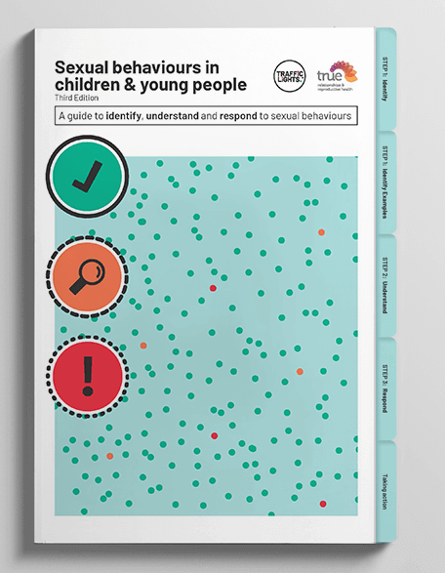
Traffic Lights® framework
The Traffic Lights® framework helps adults identify, understand and respond to children and young people’s sexual behaviours.
The guide categorises sexual behaviours into 3 levels:
  Green – typical and developmentally appropriate
  Orange – concerning
  Red - indicates or causes harm
The Traffic Lights® guide can be accessed on the Policy and Advisory Library under Mandatory reporting of harm and exploitation of children.
Notes:
The Department of Education has copyright permission from True: Relationships and Reproductive Health to share this resource with internal departmental staff.
The department does not have permission to publish these materials publicly. However, they can be used in meetings with families if appropriate.
The full framework is available on eLearn - https://elearn.ntschools.net/policies/4260
Traffic Lights® provides guidance that is age and developmentally appropriate, positive and protective.
Traffic Lights® uses the categories of green, orange and red light to help adults identify, understand, and respond to children and young people’s sexual behaviours, to support healthy sexual development and can help protect children and young people from harm or abuse.
Traffic Lights® is used by a wide variety of professionals including schools, early childhood education and care centres, health professionals, social workers, psychologists.

Slide 22
Safe Connections Program
The Safe Connections Program provides therapeutic support for children and young people aged 8–17 who display harmful sexualised behaviours. The service is trauma‑informed, holistic, and culturally responsive, tailoring support to each family’s needs. The program operates in Darwin and Alice Springs, with outreach to Katherine and Tennant Creek.
What the Program Offers:
Individual and family counselling
Trauma‑informed therapeutic interventions
Collaboration with caregivers, schools, and community services
Training and support for professionals
Contact: Email: IntakeNT@childhood.org.au Phone: 1300 381 581
Notes:
Safe Connections Program – Summary
The Safe Connections Program provides therapeutic support for children and young people aged 8–17 who display harmful sexualised behaviours. The service is trauma‑informed, holistic, and culturally responsive, tailoring support to each family’s needs. The program operates in Darwin and Alice Springs, with outreach to Katherine and Tennant Creek.
What the program offers:
• Individual and family counselling
• Trauma‑informed therapeutic interventions
• Collaboration with caregivers, schools, and community services
• Training and support for professionals
Contact:
Email: IntakeNT@childhood.org.au
Phone: 1300 381 581
Professional learning & presentations:
• Program staff can attend team meetings to explain referrals and collaboration pathways.
• Free training workshops for organisations working with children and young people.
• Training can be customised to the needs of schools, focusing on identifying, responding to, and supporting children displaying harmful sexualised behaviours.

Slide 23

Legislation

Slide 24
Care and Protection of Children Act 2007
Act promotes the wellbeing and protection of children from harm and exploitation to maximise their opportunities to develop to their full potential.
Domestic and Family Violence Act 2007
Act provides for the protection of persons in a domestic relationship against violence.
Notes:
Relevant sections of the Care and Protection of Children Act that relate to mandatory reporting.
Section 26 - every person in the NT is obliged to make a report if they believe, on reasonable grounds, a child:
has suffered, or is likely to suffer, from harm or exploitation
aged less than 14 years has been, or is likely to be, a victim of a sexual offence
has been, or is likely to be, a victim of an offence against section 128 of the Criminal Code.
Sections 27, 34 - person acting in good faith in making a report under s.26 is not civilly or criminally liable, or in breach of any professional code of conduct for:
making the report
disclosing any information in the report
giving information for inquiries.
Relevant section of the Domestic and Family Violence Act that relates to mandatory reporting
Section 124A - every adult in the NT is obliged to make a report to the police if they believe, on reasonable grounds, that either or both of the following circumstances exist:
another person has caused, or is likely to cause, harm to someone else with whom the other person is in a domestic relationship
the life or safety of another person is under serious or imminent threat because domestic violence has been, or is about to be, committed.

Slide 25
Sexual Offences (Evidence and Procedure) Act 1983
Act relates to evidence and procedure in the examination of witnesses and the trial of persons in respect of sexual offences.
Criminal Code Act 1983
Act establishes a code of criminal law.
Notes:
Relevant section of the Sexual Offences Act that relates to mandatory reporting.
Section 3 - a sexual offence is any indictable offence involving:
sexual intercourse or sexual penetration
a sexual relationship
sexual abuse
indecent touching or indecent assault
any other incident act directed against a person or committed in the presence of a child
the making, collection, exhibition or display of indecent object/material
sexual servitude or any other form of sexual exploitation
an attempt to commit, an act of procuring, or any other act preparatory to the commission of, any of the above.
Relevant sections of the Criminal Code Act that relate to mandatory reporting.
Section 127 - if the child is of, or over the age of, 10 and under the age of 16 and the offence is committed under the following circumstances:
the offender is in the company of another person
the child is (whether generally or at the time the offence is committed) under the care of the offender
the child has a serious physical or intellectual disability
the offender took advantage of the child being under the influence of alcohol or a drug in order to commit the offence
The offender is liable to imprisonment for 25 years (child under 10) and 20 years (child over 10 but under 16)
Sections 127, 128, 313A - any person who:
has sexual intercourse with, or commits any act of gross indecency upon, a child who is under the age of 16 is guilty of an offence
has sexual intercourse with, or commits any act of gross indecency upon, a child who is of, or over the age of, 16 and under the person’s special care is guilty of an offence
maintains a sexual relationship with a child under the age of 16 is guilty of an offence
Section 128 of the Criminal Code Act 1983 relates to sexual intercourse or gross indecency involving a child over 16 years under special care. Any adult who has sexual intercourse with, or commits any act of gross indecency upon, a child who is of, or over the age of, 16 years and under the person’s special care is guilty of an offence is liable to imprisonment for 4 years. If the child is of, or over the age of, 16 years and under the age of 17 years, the offender is liable to imprisonment for 8 years.
A person (the victim) is under the special care of another person (the offender) if the offender:
is the step-parent, guardian or foster parent of the victim
is a school teacher and the victim is a pupil of the offender
has established a personal relationship with the victim in connection with the care, instruction (for example, religious, sporting or musical instruction) or supervision (for example, supervision in the course of employment or training) of the victim
is an officer at a correctional institution at which the victim is detained
is a health professional or other provider of health care or treatment and the victim is a patient or client of the offender.
Section 132
Any person who:
indecently deals with a child under the age of 16
exposes a child under the age of 16 to an indecent act by the offender or any other person
permits themselves to be indecently dealt with by a child under 16
procures a child under the age of 16 to perform an indecent act
without legitimate reason, intentionally exposes a child under the age of 16 to an indecent object or indecent film, video, audio, photograph or book or
intentionally takes or records, by any device, an indecent visual image of a child under the age of 16 is guilty of an offence.

Slide 26

National Principles for
Child Safe Organisations

Slide 27
National Principles for Child Safe Organisations
Child safety and wellbeing is embedded in organisational leadership, governance and culture.
Children and young people are informed about their rights, participate in decisions affecting them and are taken seriously.
Families and communities are informed and involved in promoting child safety and wellbeing.
Equity is upheld and diverse needs respected in policy and practice.
People working with children and young people are suitable and supported to reflect child safety and wellbeing values in practice.
Notes:
https://childsafe.humanrights.gov.au/national-principles
PDF version https://childsafe.humanrights.gov.au/sites/default/files/2019-02/National_Principles_for_Child_Safe_Organisations2019.pdf

Slide 28
National Principles for Child Safe Organisations
Processes to respond to complaints and concerns are child focused.
Staff and volunteers are equipped with the knowledge, skills and awareness to keep children and young people safe through ongoing education and training.
Physical and online environments promote safety and wellbeing while minimising the opportunity for children and young people to be harmed.
Implementation of the national child safe principles is regularly reviewed and improved.
Policies and procedures document how the organisation is safe for children and young people.

Slide 29

Reporting

Slide 30
When to report
As soon as possible once a belief has been formed, on reasonable grounds, that a child has suffered, or is likely to suffer, harm or exploitation.
Notes:
A report must be made as soon as possible once a belief has been formed, on reasonable grounds, that a child:
has suffered, or is likely to suffer, harm or exploitation
aged less than 14 years has been, or is likely to be, a victim of a sexual offence
aged less than 14 years is, or is likely to be, sexually active even if that child’s parent is aware of the situation
over the age of 16 years and in a special care relationship has been, or is likely to be, a victim of an offence according to the Criminal Code Act
is exposed to domestic and family violence
has been, or is likely to be, a victim of criminal or sexual offences, including sexual misconduct against a student by a co-worker or colleague.
A belief, on reasonable grounds, may be based on:
disclosure by a child
allegations by a third party such as a report by one child in relation to another child
observations of physical indicators such as injuries or fear
observations of age-inappropriate behaviours such as sexualised behaviour or talk (refer to the Sexual Behaviour in Children Guidelines)
delays in emotional or mental development
chronic non-school attendance.
If there is any doubt as to whether a mandatory report should be made or who it should be made to, advice and guidance is available from the 24/7 Child Protection Reporting Line by calling 1800 700 250.

Slide 31
Who makes the report
The person, adult, who has formed the belief that a child may have been, or is at risk of being, harmed or exploited must make the report.
This is a legal requirement and ensures that the most accurate and reliable information is reported.
All reports are confidential. A reporter’s identity will not be disclosed, confirmed or denied nor will the reporter’s identity be included in documents prepared for court, except where the court orders the information to be provided.
Section 27 of the Care and Protection of Children Act protects a person making a report from civil or criminal liability if they have done so in good faith.
Notes:
Staff who experience stress or anxiety as a result of making a report can access professional counselling and support through the Employee Assistance Program by calling 1800 432 303.

Slide 32
How to make a report
If the situation to be reported is an emergency, and the young person is at immediate risk, telephone 000 and ask for police.
If it is not an emergency, there are two ways to report:
Submitting an online report on DCF’s CARE Services Portal https://careservices.nt.gov.au/web/portal/pages/home
Calling the Child Protection Hotline on 1800 700 250.
Notes:
Informing Quality Education and Care Northern Territory (QECNT) is a requirement under the Education and Care Services National Uniform Legislation Act.
Changes have been made to the reporting process.

Slide 33
How to make a report
First time users of the CARE Services portal will need to create an account and log in each time they lodge a report.
There are three situations when the online portal cannot be used and the report should be lodged through the reporting line, when:
  the name of the child is not known
  the concerns are for an unborn child, or
  concerns are for children from different families, a separate report must be lodged for each family group.
Instructional videos on how to use CARE Service Portal https://tfhc.nt.gov.au/children-and-families/care-services/get-help-using-care-services

Slide 34
Other reporting obligations
Also make a report to police on 131 444 or at the local police station if the following are involved:
  domestic, family or sexual violence
  criminal or sexual offences, including sexual misconduct against a student by a co-worker or colleague
Report to Quality Education and Care Northern Territory (QECNT) through the National Quality Agenda IT System (NQAITS) https://www.acecqa.gov.au/resources/national-quality-agenda-it-system if the incident involved a child enrolled in an early childhood education program and the incident occurred on the program site.
This is a requirement under the Education and Care Services (National Uniform Legislation) Act 2011. QECNT can be contacted directly on 08 8999 3561 or qualityecnt.det@education.nt.gov.au.
Notes:
Lodge report to QECNT through NQAITS system, QECNT can be contacted during business hours on on 08 8999 3561 or qualityecnt.det@education.nt.gov.au

Slide 35
What do I need to report?
IDENTIFYING INFORMATION | CURRENT SITUATION
Names Dates of birth Addresses of the child, parents/caregivers Who is the alleged perpetrator? Details of other household members. | Whereabouts of the child and other family members Who is aware of the report being made.
DESCRIPTION OF HARM | OTHER RELEVANT INFORMATION
Description of the injury Description of abusive or neglectful indicators observed Details of the history of abuse (when you first become concerned) Reasons for believing the injury or behaviour is the result of abuse or neglect. | Other agencies involved Family strengths Other relevant family information.
Notes:
The Department of Territory Families, Housing and Communities will use the information provided, any existing information about the family and their own enquiries to assess whether the child is in need of care and protection.
Three new questions added to “information about”
what challenges the family may be experiencing
any professional services involved with the child or family
what has been working well for the child or family.

Slide 36

Support and Resources

Slide 37
Self-care
Build reporting and support processes within your team or unit.
Seek support when a matter has affected you on a personal or professional level.
The Employee Assistance Program (EAP) is a short-term counselling and advisory services for all NT Government employees to seek professional assistance for any personal or work-related problems.
It is easily accessible, free and confidential.
Face to face counselling.
Skype counselling.
telephone counselling.
Notes:
Support for staff is available through the Employee Assistance Program (EAP).
EAP is a short-term counselling and advisory services for all NT Government employees to seek professional assistance for any personal or work-related problems.
It is easily accessible, free and confidential.
face to face counselling
online counselling
telephone counselling.

Slide 38
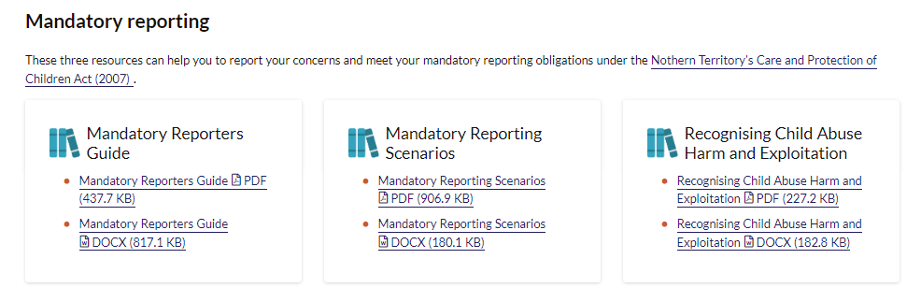
DCF – get help reporting a concern
DCF provides further resources on using the CARE Services portal and reporting a concern.
Notes:
https://tfhc.nt.gov.au/children-and-families/care-services/get-help-reporting-a-concern

Slide 39
Make a meaningful mandatory report booklet
A meaningful mandatory report booklet is an additional resource developed by the department in consultation with DCF.
It includes:
steps on making a mandatory report
explicit guidance on scenarios regularly reported by schools
support contacts and links for staff and families.
A meaningful mandatory report booklet can be accessed on the Policy and Advisory Library under Mandatory reporting of harm and exploitation of children.
Notes:
https://elearn.ntschools.net/policies/4260
Mandatory reporting of harm and exploitation of children | eLearn (ntschools.net)

Slide 40
SWIPS Duty Worker
A SWIPS Duty Worker is rostered weekly to support schools to manage critical and priority wellbeing and safety tasks for NT government schools.
The Duty Worker is a member of the Critical Incident Response Team (CIRT) and supports Principals during complex incidents or scenarios.
Duty Worker can provide guidance and support on:
Child protection matters, including mandatory reporting.
Harmful sexual behaviors: identification, traffic-light guidance, and advice on appropriate responses.
Availability: Monday–Friday, 8:00am–4:21pm.
Phone: 8944 9346
Email: swipsdutyworker.de@education.nt.gov.au

Slide 41
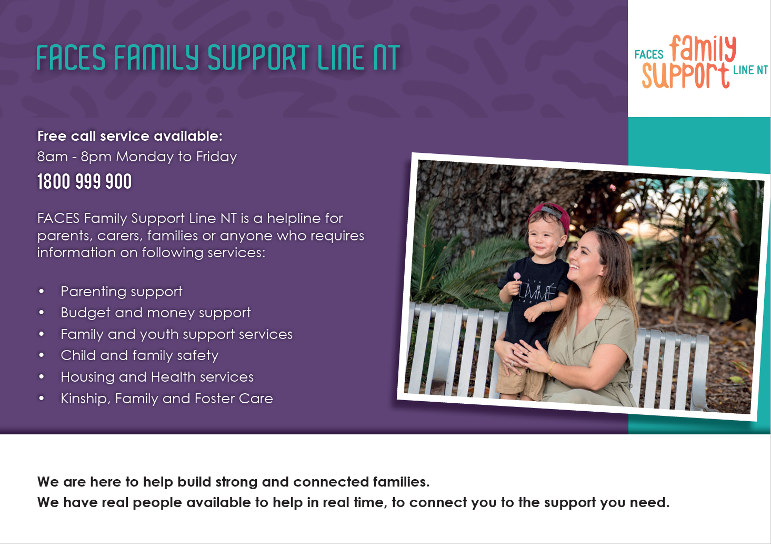
Prevention of child harm and exploitation
Child harm and exploitation can be prevented.
Alternative services outside the DCF can help.
DCF Enquiry and Support (Territory FACES) can provide information about referrals to external services and agencies.
Notes:
The Territory FACES team connects Territorians with services or resources that support parents and families in an identified area. It is a non statutory referral service.
Can be used by anyone living in the Northern Territory, and the service can be used as often as a child, parent or family requires.
Consent from families is required.
Finding family support services can be time consuming and difficult. The FACES team is a phone service that can help with a range of family and parenting needs. The team talk with callers about their situation and work out the type of support which they may find helpful. FACES can provide a referral service for families directly or work with providers and other professionals working with the family to identify available services and resources.
The Territory FACES team will connect Territorians with services or resources that support parents and families in their area to:
build parents’ capacity to deal with the everyday challenges of parenting such as behavioural issues, homework, skipping school and parent-teen conflict;
building stronger family relationships;
Practical home support;
budgeting and managing money;
accessing crisis accommodation, health-care or access to other community or government services.
Territory FACES and Central Intake
In some circumstances, there can be collaborative and supportive communication between Children and Families and the Children and Families Central Intake Unit around providing support to families. When a notification does not proceed to an investigation, Central Intake can refer the family on to FACES for support.
If Territory FACES cannot provide support to a child or family, the Central Intake Unit can provide family support in a range of areas including parenting support, youth support, family preservation and family arrange placements.

Slide 42
Questions or comments?

